Slide 1
SQL
Structured Query Language

Slide 2
01
Introduction
Structured Query Language

Slide 3
what is SQL
Structured query language (SQL) is a programming language for storing and processing information in a relational database. A relational database stores information in tabular form, with rows and columns representing different data attributes and the various relationships between the data values. You can use SQL statements to store, update, remove, search, and retrieve information from the database. You can also use SQL to maintain and optimize database performance.

Slide 4


What Can SQL do?
SQL can execute queries against a database
SQL can retrieve data from a database
SQL can insert records in a database
SQL can update records in a database
SQL can delete records from a database
SQL can create new databases
SQL can create new tables in a database
SQL can create stored procedures in a database
SQL can create views in a database
SQL can set permissions on tables, procedures, and views

Slide 5
02
Project
Blood Bank Management

Slide 6
BLOOD BANK MANAGEMENT

Slide 7
Aim of the Project
This project focuses on managing a blood bank dataset through SQL, overseeing blood types, donors, recipients, and units.
It demonstrates expertise in healthcare data handling, optimizing blood supply, and ensuring timely availability. The project showcases skills in data management and analysis within the sensitive environment of a blood bank. Aggregate functions to summarize and analyze blood bank data. Optimizing SQL queries for efficiency and performance in managing large datasets.

Slide 8
INFORMATION OF ENTITIES
In total, we have eight entities, and information on each entity is mentioned below:-
Blood_Donor: (Attributes – bd_ID, bd_name, bd_sex, bd_age, bd_Bgroup, bd_reg_date, bd_phNo)
Recipient: (Attributes – reci_ID, reci_name, reci_age, reci_Bgrp, reci_Bqnty , reci_sex, reci_reg_date, reci_phNo)
BB_Manager: (Attributes – m_ID, m_Name, m_phNo)

Slide 9
reco_ID, reco_Name, reco_phNo)
4.Recording_Staff : (Attributes
5. BloodSpecimen : (Attributes
specimen_number, b_group, status)
DiseaseFinder: (Attributes - dfind_ID, dfind_name, dfind_PhNo)
Hospital_Info : (Attributes hosp_ID, hosp_name, hosp_needed_Bgr, hosp_needed_Bqnty)
city: (Attributes- city_ID, city_name)

Slide 10
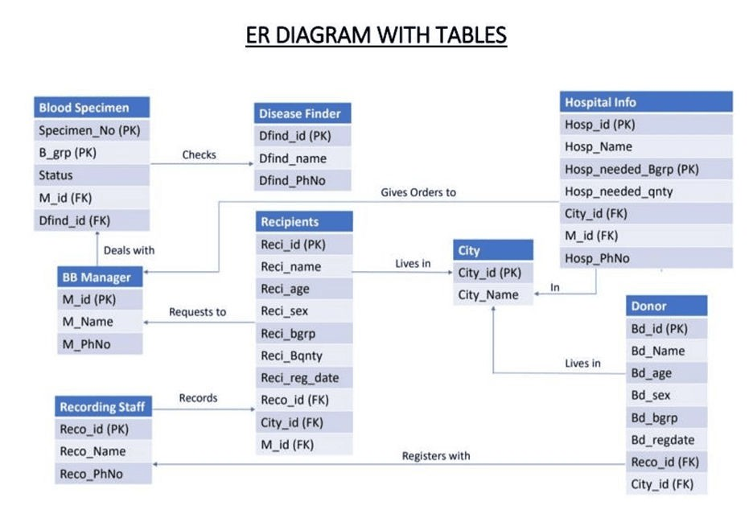
ER diagram

Slide 11
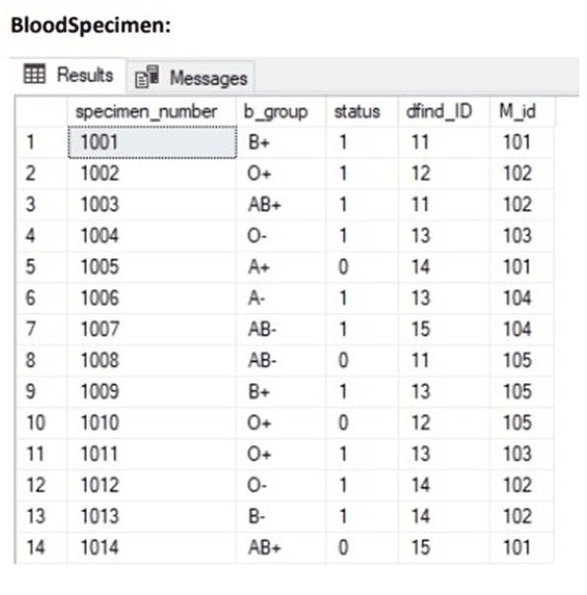
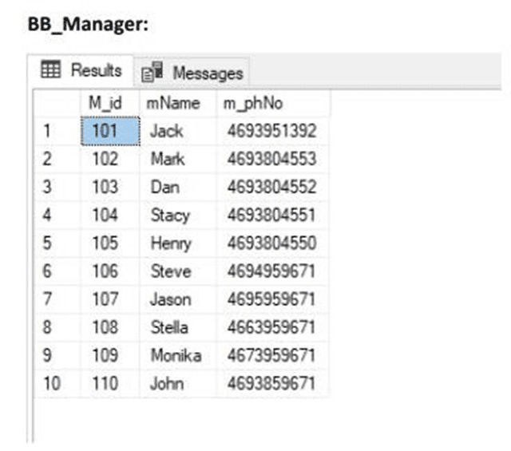
TABLES AFTER NORMALIZATION

Slide 12
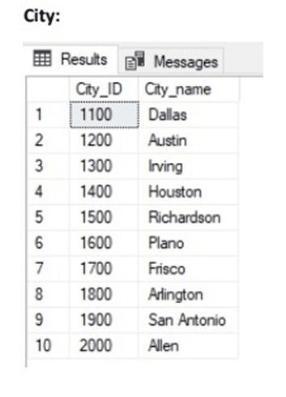
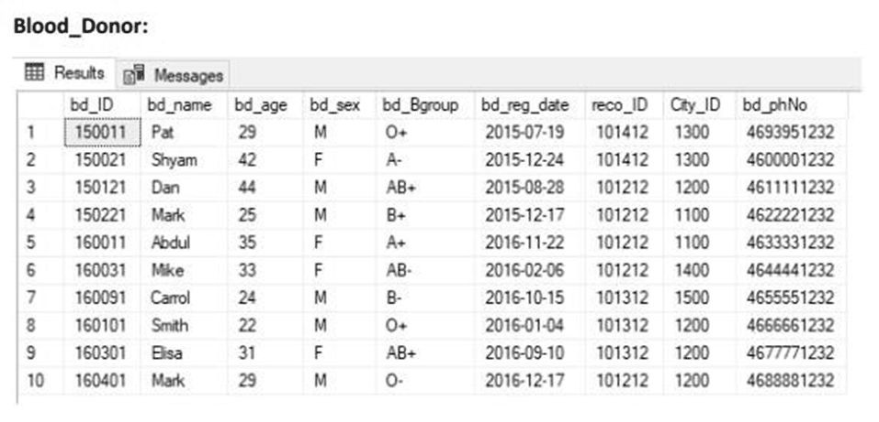

Slide 13
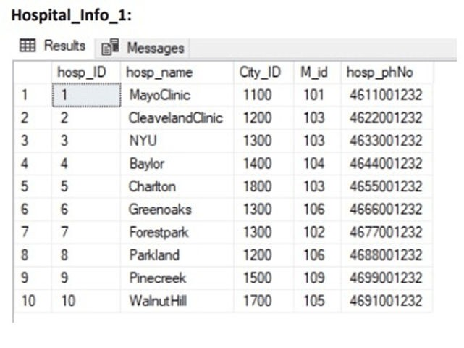
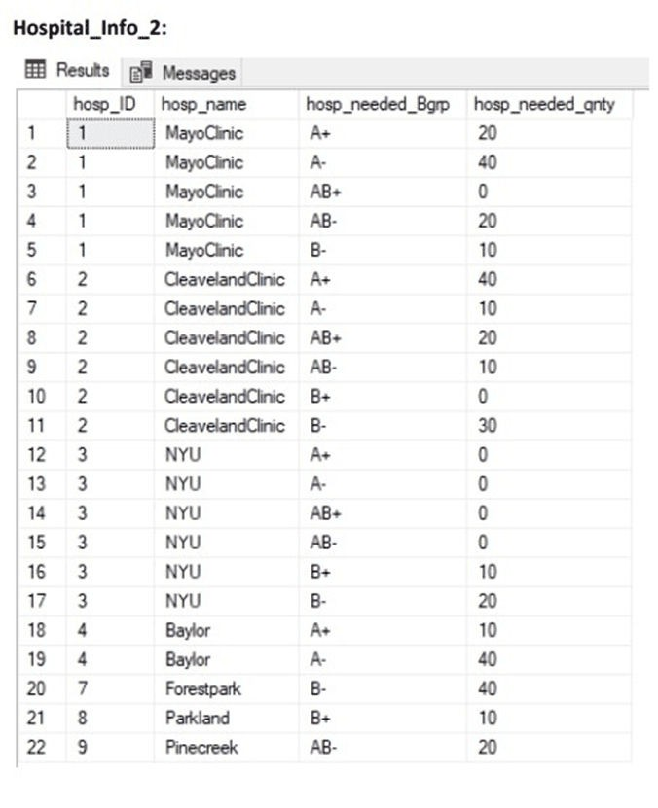

Slide 14
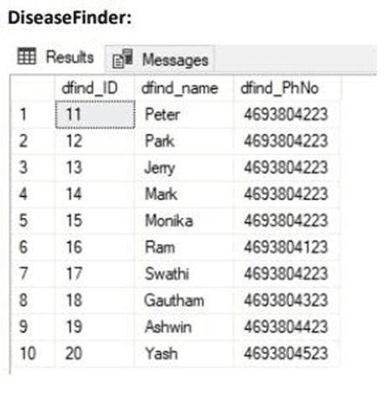
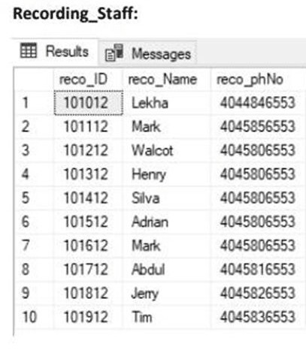
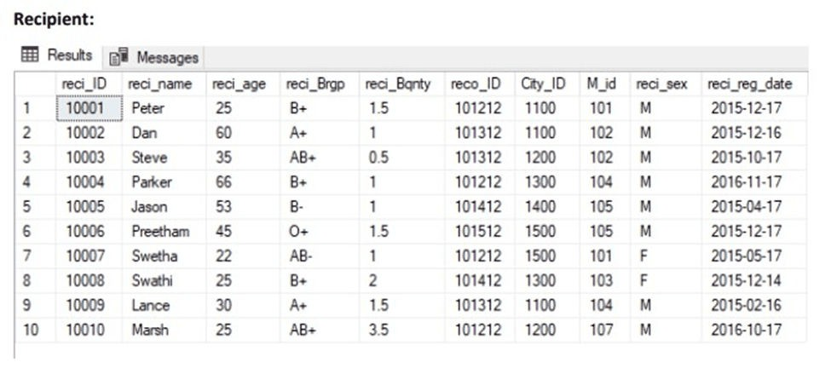

Slide 15
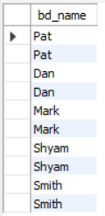
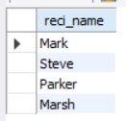
Queries
1. Retrieve the names of 10 blood donors ordered by their registration dates ?
SELECT bd_name
FROM Blood_Donor
ORDER BY bd_reg_date limit 10;
2. Retrieve the names of recipients who are male, aged between 20 and 80, and need blood of type 'B+' or 'AB+’ ?
SELECT reci_name
FROM Recipient
WHERE reci_sex = 'M' AND reci_age
BETWEEN 20 AND 80 AND (reci_Brgp = 'B+' OR reci_Brgp = 'AB+');

Slide 16
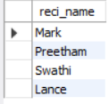
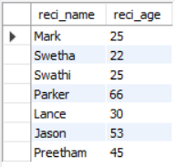
3. Retrieve the names of recipients who have a blood quantity greater than 1 and are from cities other than 'Irving’?
SELECT reci_name FROM Recipient WHERE reci_Bqnty > 1 AND City_ID NOT IN (SELECT City_ID FROM City WHERE City_name = 'Irving');
4. Find the names and ages of all recipients who are registered in hospitals located in cities other than Houston.
SELECT distinct r.reci_name, r.reci_ageFROM Recipient rJOIN Hospital_Info_1 hi ON r.M_id = hi.M_idJOIN City c ON hi.City_ID = c.City_IDWHERE c.City_name <> 'Houston' limit 8;

Slide 17


5. Find Recipients with Blood Quantity Greater Than a Specified BLOOD Quantity > 2 ?
SELECT reci_name, reci_Bqnty
FROM Recipient
WHERE reci_Bqnty > 1.5
6. Find Blood Donors Who are Female and Aged Between 30 and 40 ?
SELECT bd_name, bd_age, bd_sex
FROM Blood_Donor
WHERE bd_sex = 'F' AND bd_age
BETWEEN 30 AND 40;

Slide 18
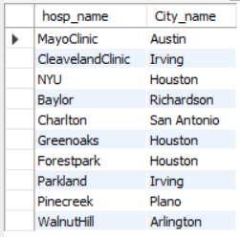
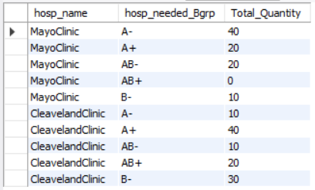
7. List the hospitals along with their names and the corresponding city they are located in ?
SELECT h.hosp_name, c.City_name
FROM Hospital_Info_1 h
JOIN City c ON h.City_ID = c.City_ID;
8. List the blood groups along with the total quantity needed in each hospital ?
SELECT hosp_name, hosp_needed_Bgrp, SUM(hosp_needed_qnty) AS Total_Quantity
FROM Hospital_Info_2
GROUP BY hosp_name, hosp_needed_Bgrp;

Slide 19
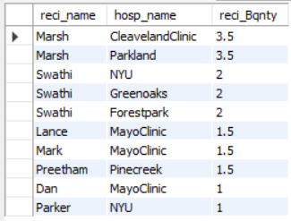
9. Retrieve the 10 names of recipients along with the hospitals they are associated with, ordered by the quantity of blood needed in descending order.
Query to Retrieve Data :
SELECT distinct r.reci_name, hi.hosp_name, r.reci_Bqnty FROM Recipient r
JOIN Hospital_Info_1 hi ON r.City_ID =
hi.City_ID
ORDER BY r.reci_Bqnty DESC limit 10;

Slide 20
THANK YOU

